Slide 1
Flood Prediction Using AI
Team Members:
Project Guide:
Ajay Karthik
Chaitanya Thekkunja
Kishan Kashyap
Shubhang
Dr. Shivakumar G S

Slide 2
Contents:
Introduction.
Problem Statement.
Existing System.
Proposed System.
System Design.
Tools used.
Result Analysis.
Conclusion.

Slide 3
Introduction:
Flood prediction is the use of forecasted precipitation and stream-flow data in rainfall-runoff and stream-flow routing models to forecast flow rates and water levels. Flood prediction can also make use of forecasts of precipitation in an attempt to extend the lead-time available. Flood prediction is an important component of flood warning, where the distinction between the two is that the outcome of flood prediction is a set of forecast time-profiles of channel flows or river levels at various locations.

Slide 4
Problem Statement:
Among the natural disasters, floods are the most destructive, causing massive damage to human life, infrastructure, agriculture, and the socioeconomic system. Governments, therefore, are under pressure to develop reliable and accurate maps of flood risk areas and further plan for sustainable flood risk management focusing on prevention, protection, and preparedness.

Slide 5
Existing System:
Physically based models were used to predict hydrological events.
Although physical models showed great capabilities for predicting a diverse range of flooding scenarios, they often require various types of hydro-geomorphological monitoring datasets, requiring intensive computation, which prohibits short-term prediction.
Numerous studies suggest that there is a gap in short-term prediction capability of physical models. For instance, on many occasions, such models failed to predict properly.

Slide 6
Proposed Solution:
Our system aims to collect data from all the states of India and form a generalized dataset.
A machine learning algorithm is applied to the labelled dataset, and patterns are extracted, which, in turn, obtain maximum accuracy with real-time input.
In general, the dataset collected for predicting is split into a Training set and Test set. Generally, 7:3 ratios are applied to split the Training set and Test set.
The Data Model is then created using a Multi-Layer Perceptron Classifier, and the resulting data set is then passed through it for prediction.

Slide 7
System Design
To get the required data, we use an API. The data is then cleaned up, such that any information that is not relevant, missing values, duplicate values etc. are ignored and only the relevant data is used for the next step which is splitting the data into two parts, training data and testing data.
The data is then passed to the AI models for training.
The trained model is then used to predict the possibility of flooding.

Slide 8
Steps:
Step 1: Input the region of which flood needs to be predicted from the drop down.
Step 2: Input the time of year for the prediction.
Step 3: Based on the given data, select the region and time of year from the dataset.
Step 4: Pre-process the data to remove any duplicates, null values etc.
Step 5: Display graphs and other statistics related to the selected information.
Step 6: Split the data into two sets, training and test set.
Step 7: Input the data into the different models.
Step 8: Get the predictions from the models and output the prediction along with the
accuracy.

Slide 9
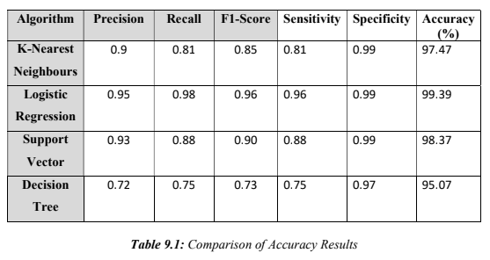
Result Analysis

Slide 10
Conclusion
This is not straightforward owing to the variety of flood forecasting and warning systems. This research concludes that the statistical uncertainty quantification methods can answer the question: what is the probability of the forecasts being accurate based on past performance? This method should be applied when the users require an estimation of the uncertainty of a flood forecast as probabilistic bands based on the historical rainfall data. The model is to predict the flood using machine learning algorithms, which gave different results. From the above observations and analysis, the best algorithm for flood prediction is the Logistic Regression (99%).

